Slide 1
Business Problem
The company seeks to analyse its global sales performance across different regions, countries, segments, and product categories.

Slide 2
Project Goals Phase One
The goal is to identify the key drivers of profitability and sales trend by exploring:
1.The impact of discount bands on total sales and profitability.
2. sales performance of Product across different countries and segments.
3. Temporal trends in Monthly sales
4. The relationship between, sales Price, and profit margins.
5. Identification of high performing regions, Products and time Periods.
This analysis will help stakeholder make data-driven decisions on pricing strategy, inventory management, marketing allocations, and product development

Slide 3
STEPS AND PROCEDURE TAKEN FOR THE SUCCESS OF THIS PROJECT
Understanding the Business Problem and Asking Questions that will Help Achieve Our project Goal
Preparing the data we need to solve the problem we have at hands, Data source : Kaggle
Processing the Data with excel for smooth analysis and finding outlier, correcting the data type into the right format
Preliminary Analysis on Excel and Main Analysis was on excel and power bi
Share Phase or the Dashboard Creation was Done on Power bi and Google Slide

Slide 4
FINDINGS AND RECOMMENDATION

Slide 5
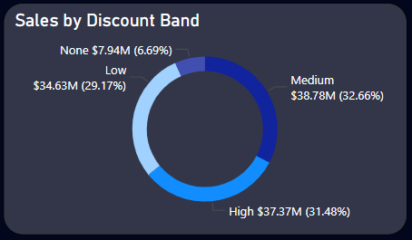
The impact of discount bands on total sales and profitability
Findings from the dataset shows that even though the the amount of discount does not necessary affect the overall sales, we were able to discover that there were more sales when customers experience discount, which makes the medium and High Discount band overall Sales Higher than Sales without Discount

Slide 6
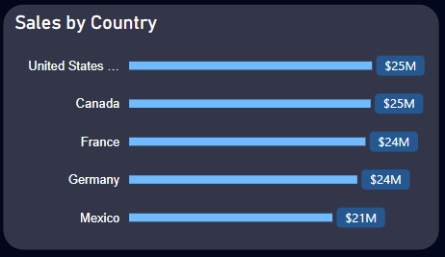
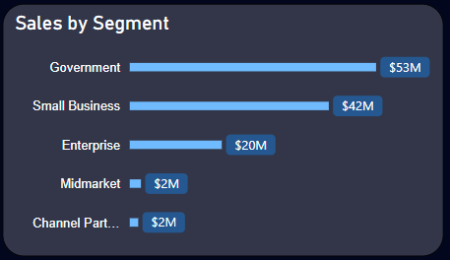
sales performance across different countries and segments
Sales were generally Good in All Countries, Even though We had Better Sales in United State, Canada, France, Germany, mexico was Lower compare to the others
=========================
Higher Sales were Generated through Government, Small Business segment and Enterprises but Midmarket and channel part was especially Low

Slide 7
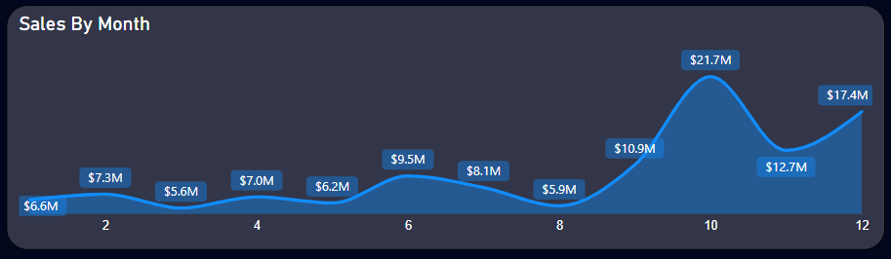
Temporal trends in Monthly and Yearly sales
Overall Sales From the Beginning of the first quarter to the second quarter was quite poor But there was a sudden Surge towards the end of the third Quarter to the end of the Fourth Quarter

Slide 8
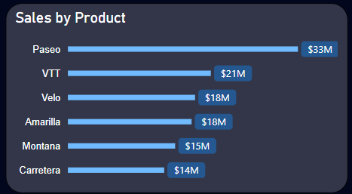
Sales Performance of Product
Overall Sales Performance of Product was Great, Product like Paseo, VTT performed Way more better than The other products

Slide 9
Impact of discount band on sales
From observation and further analysis, we were able to discover that discount band has a major role to play in sales, sales with discounts tends up to bring in more sales capital than that without discount, We would encourage that Team should approach this in a way in which they can explore discount band in favors of the customers maybe once or twice to encourage customer interactions with products.
While Exploring the profitability that comes with different discount bands, i also notice that the Total Profit made on sales with High discount was lower to that of profit that comes with low discount, we should look into the discount range on the low discount band and see if we can use the price ranges to judge the perfect discount range that will enhance and promote additional sales for the high discount band.

Slide 10
Temporal trends in Monthly sales
Overall monthly Trend: Analysis shows that there is always a slow start from the beginning of the first quarter of the year all the way to the third quarter, and sales experience a sudden surge towards the end of the third quarter right on to the rest of the year, I would recommend looking into why sales is low during the early part of the year and i would also recommend that we consider focusing on how we can better sales during this time, we could employ tactics as generating new advertisement plan or we can even run some special discount during these times since our analysis confirms that the more discount the more sales generated.

Slide 11
Sales performance of Product across different countries and segments
From Analysis we notice that the top three products with the highest sales has more sales from the Government and the small business and enterprise segment, we also observed that they all have the same confluence with countries, since we are generating more sales from these areas we can focus more on why sales are not as good on the other segment and countries

Slide 12
The relationship between, sales Price, and profit margins
Looking Into The relationship between sales Price and Profit, I decided to look into the average sales price of each product and the result of my analysis shows that there is little to no relations as to why the sales price will determine the profit generated by the Product but then i decided to look into the Average manufacturing price and compare it to the average sales price of each product and i discovered that, Paseo who had the highest profit had an average manufacturing price of $10 while the average sales price was $110 dollars, Product like (VTT, Amarilla, Velo) which average manufacturing price is higher than the average sales price would do better if we can find the perfect balance between the manufacturing price and the sales price given to this product.

Slide 13
Identification of high performing regions, Products and time Periods.
From the result of our analysis, we discovered that we have more sales in canada and and United state more than france Germany and Mexico, even though the sales total was kind of relative to each other, Mexico was very low compare to the other Four Countries, I believe that we can look into sales in this Mexico to Figure out the root cause of the problem

